Slide 1

Ministry of Investment, Trade & Industry
HALAL COMPLIANCE EXECUTIVE TRAINING: CU 1
HALAL TRAINING INSTITUTE (HTI)

Slide 2
TRAINING AGENDA
CU 1
CU 2
CU 3
CU 4
CU 5
Halal Manual & Record Administration
Internal Halal Management Team (IHMT) / Internal Halal Committee (IHC)
Halal Assurance System
Halal Certification Process Administration
Halal Internal Audit Facilitation

Slide 3
TRAINING CONTENT
CU 1: Halal Manual & Record Administration
Introduction
Halal Policy & Management Commitment
Halal Assurance System (HAS) Overview
Halal Control & Documentation System

Slide 4
CU 1:
Halal Manual & Record Administration

Slide 5
INTRODUCTION
The Halal Manual serves as the primary reference document describing the organization’s Halal Assurance System (HAS).
It outlines the policies, procedures, responsibilities, and controls established to ensure continuous compliance with halal requirements.
The manual applies to all activities, processes, products, and personnel involved in halal-related operations.
It supports compliance with halal standards (e.g. MS 1500), Halal Assurance System requirements and Relevant statutory and regulatory requirements

Slide 6
PURPOSE OF HALAL MANUAL
Establish a documented framework for the implementation and maintenance of the Halal Assurance System (HAS).
Define the organization’s commitment, policies, and controls to ensure continuous compliance with halal requirements.
Provide a standard reference for managing halal-related activities across all operational functions.
Ensure consistency and traceability in halal practices, procedures, and records.
Serve as an official document for halal certification, audits, and regulatory compliance.
Support effective communication of halal requirements to employees, suppliers, contractors, and relevant stakeholders.

Slide 7
OBJECTIVE OF HALAL MANUAL
Ensure all products and services consistently comply with applicable halal standards, fatwa rulings, and regulatory requirements.
Define roles, responsibilities, and authorities related to halal assurance within the organization.
Establish clear procedures and controls to prevent halal contamination and non-compliance.
Provide guidance for documentation and record management as evidence of halal compliance.
Facilitate effective implementation, monitoring, and verification of the Halal Assurance System.
Support internal halal audits, management reviews, and corrective actions.
Promote continuous improvement in halal management practices.

Slide 8
IMPORTANCE OF HALAL MANUAL
The Halal Manual is not a religious book
It is a management system document, similar to:
Quality Manual
Food Safety Manual
It explains:
How halal risks are controlled
Who is responsible
What records are required
Halal compliance is achieved through system and discipline, not religious belief

Slide 9
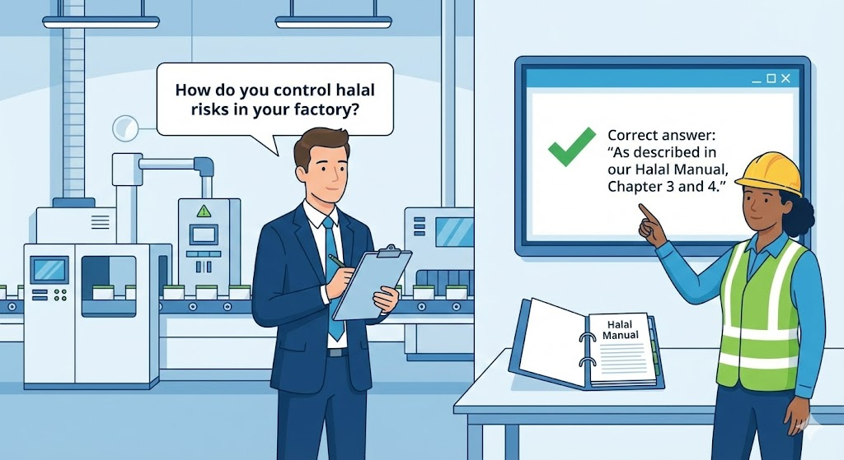
IMPORTANCE OF HALAL MANUAL
📌 Audit Example
Rather than giving a vague or personal explanation, she points to the official documentation.
The Halal Manual: There is a physical binder on the desk labeled "Halal Manual," showing that the factory has a structured, written system in place.
By citing "Chapter 3 and 4," she demonstrates that the factory’s risk management is standardized and that employees are trained to follow specific, documented protocols.

Slide 10
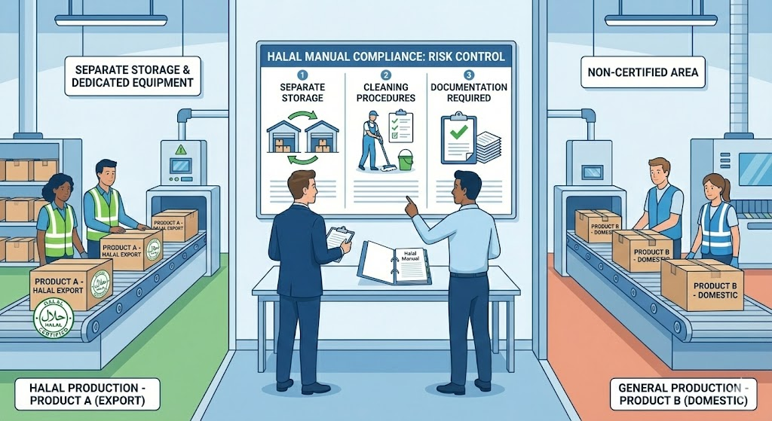
IMPORTANCE OF HALAL MANUAL
Factory produces:
Product A: Halal export
Product B: Non-certified halal domestic
Halal Manual explains:
Separate storage
Cleaning procedures
Documentation required

Slide 11
HALAL POLICY & MANAGEMENT COMMITMENT INTRODUCTION
If no signed policy → Major NCR risk
A formal written commitment
What is a Halal Policy?
Signed by CEO / General Director
Management seriousness
To shows auditors:
Accountability

Slide 12
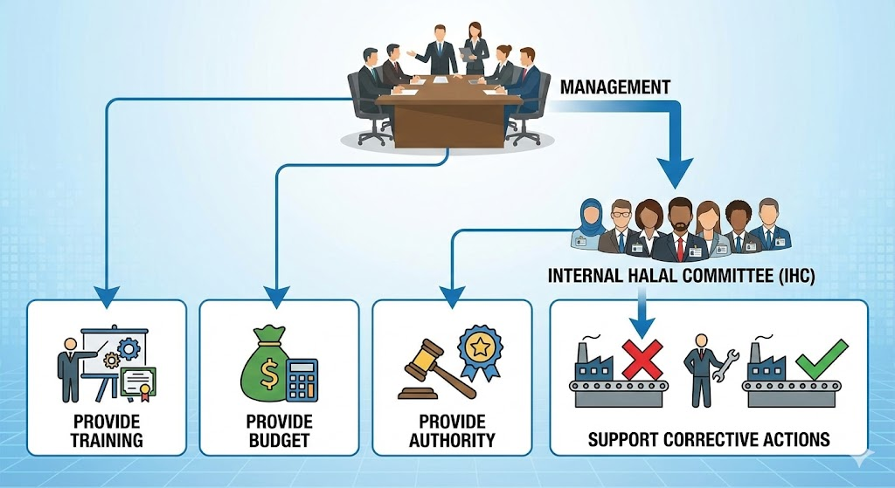
HALAL POLICY & MANAGEMENT COMMITMENT INTRODUCTION
What Management Must Do
Appoint Internal Halal Committee (IHC)
Provide:
Training
Budget
Authority
Support corrective actions

Slide 13

HALAL POLICY & MANAGEMENT COMMITMENT INTRODUCTION
Good Practice Example
CEO signs Halal Policy
Policy displayed at:
Production area
QA office
Employees trained on policy
❌ Bad Practice
Policy exists but not signed,
employees unaware,
only kept for audit

Slide 14
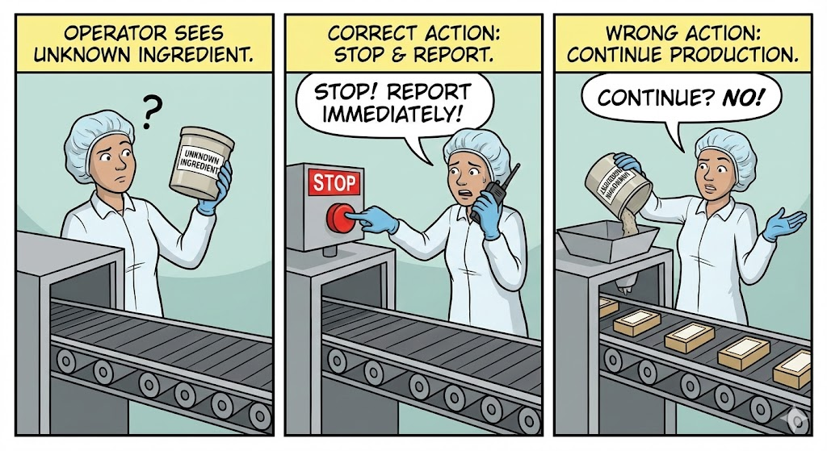
HALAL POLICY & MANAGEMENT COMMITMENT INTRODUCTION
Role of Employees
Employees do NOT need to understand religion, but must:
Follow SOP
Use approved materials
Report abnormalities

Slide 15
HALAL POLICY & MANAGEMENT COMMITMENT ESTABLISHMENT
WHAT IS A HALAL POLICY?
A Halal Policy is a top management commitment statement.
It is not a religious declaration.
It is a business and compliance policy, like:
Quality Policy
Food Safety Policy
If top management does not commit, the system will not be effective.

Slide 16
HALAL POLICY & MANAGEMENT COMMITMENT ESTABLISHMENT
HALAL POLICY STRUCTURE:
Organization Commitment Statement
Compliance & Standards Reference
Control of Materials & Processes
Continuous Improvement Commitment
Roles, Resources & Responsibility
Communication & Implementation

Slide 17

HALAL POLICY & MANAGEMENT COMMITMENT ESTABLISHMENT
Organization Commitment Statement
States who is committing
Mentions halal compliance clearly
🔹 Required wording elements:
Company name
Commitment to halal markets
Compliance obligation

Slide 18

HALAL POLICY & MANAGEMENT COMMITMENT ESTABLISHMENT
2. Compliance & Standards Reference
Mentions applicable halal standards
Shows awareness of certification authority
🔹 Examples:
TCVN 12944:2020
TCVN 13708:2023
MS 1500
Recognised halal certification bodies

Slide 19
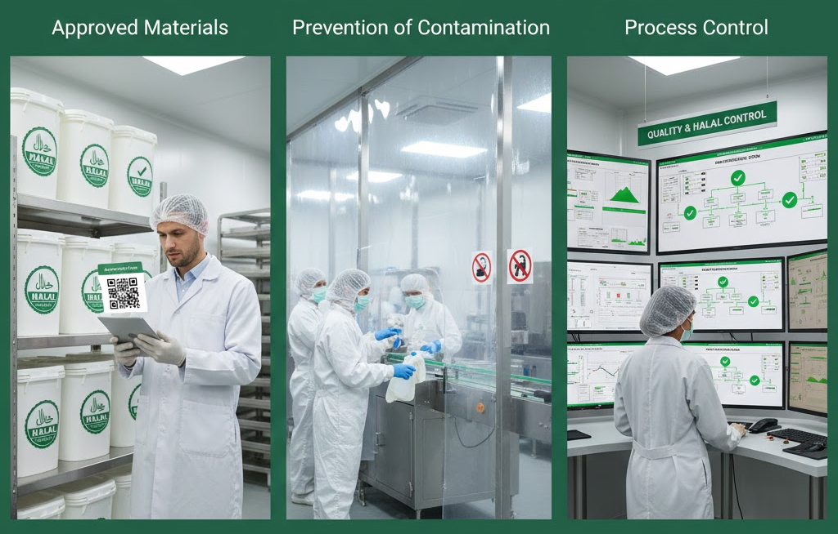
HALAL POLICY & MANAGEMENT COMMITMENT ESTABLISHMENT
3. Control of Materials & Processes
Focus on technical controls, not beliefs
Very important for non-Muslim factories
🔹 Must mention:
Approved materials
Prevention of contamination
Process control

Slide 20
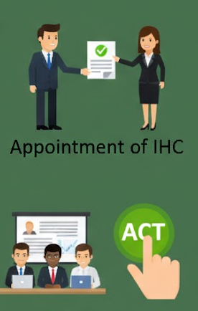
HALAL POLICY & MANAGEMENT COMMITMENT ESTABLISHMENT
4. Roles, Resources & Responsibility
Shows management support
Auditors look for this line
🔹 Must include:
Appointment of IHC/Halal Management Team
Training
Authority to act

Slide 21


HALAL POLICY & MANAGEMENT COMMITMENT ESTABLISHMENT
5. Continuous Improvement Commitment
Shows system thinking
Aligns with ISO principles
🔹 Must include:
Review
Improvement
Corrective action

Slide 22


HALAL POLICY & MANAGEMENT COMMITMENT ESTABLISHMENT
6. Communication & Implementation
Shows policy is not just paper
Very common audit question
🔹 Must mention:
Communication to employees
Availability to stakeholders

Slide 23
HALAL POLICY & MANAGEMENT COMMITMENT ESTABLISHMENT
WORDING – WHAT LANGUAGE TO USE
✅ GOOD WORDING
“shall ensure”
“are committed to”
“maintain”
“comply with”
“prevent”

Slide 24
HALAL POLICY & MANAGEMENT COMMITMENT ESTABLISHMENT
❌ AVOID WORDING
Emotional phrases
Vague commitments like:
“try to”
“as much as possible”
“where applicable” (without control)

Slide 25
HALAL POLICY & MANAGEMENT COMMITMENT ESTABLISHMENT
HALAL POLICY – DRAFTING TEMPLATE
HALAL POLICY
We, [Company Name], are committed to ensuring that all products manufactured comply with applicable halal requirements and regulatory standards.
We shall ensure that:
Only approved halal raw materials, ingredients, and suppliers are used.
Halal integrity is maintained throughout receiving, storage, processing, packaging, and distribution.
Cross-contamination with non-halal materials is prevented through effective controls and procedures.
A Halal Assurance System (HAS) is established, implemented, and maintained.
Adequate resources, training, and authority are provided to the Internal Halal Committee (IHC) and relevant personnel.
The effectiveness of halal controls is reviewed and continuously improved.
This Halal Policy is communicated to all employees and made available to relevant stakeholders.
Signed by: Name: ________________________ Designation: [Chief Executive Officer] Signature: ____________________ Date: ________________________

Slide 26
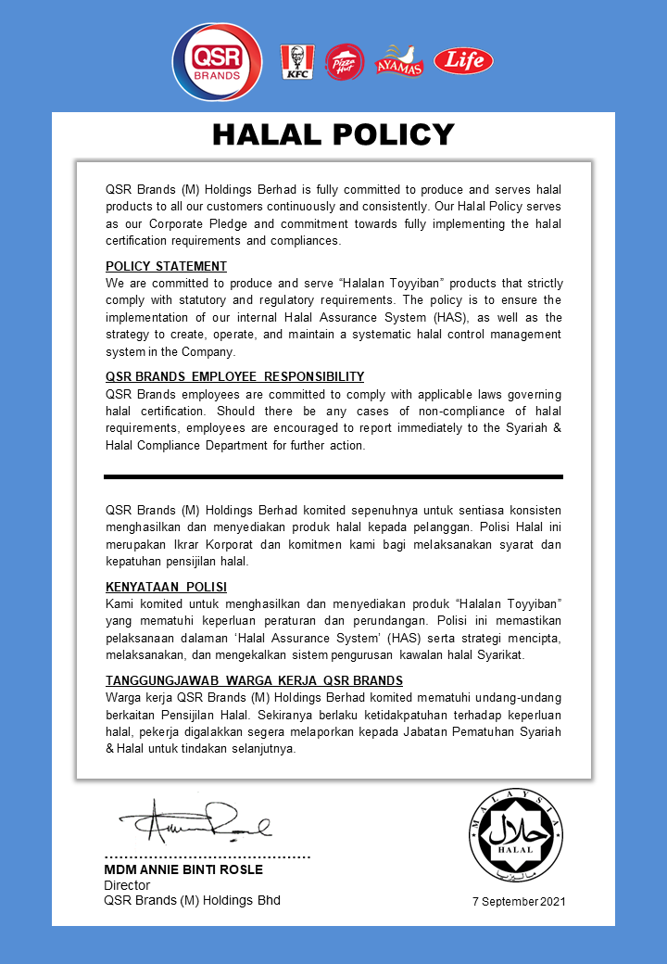
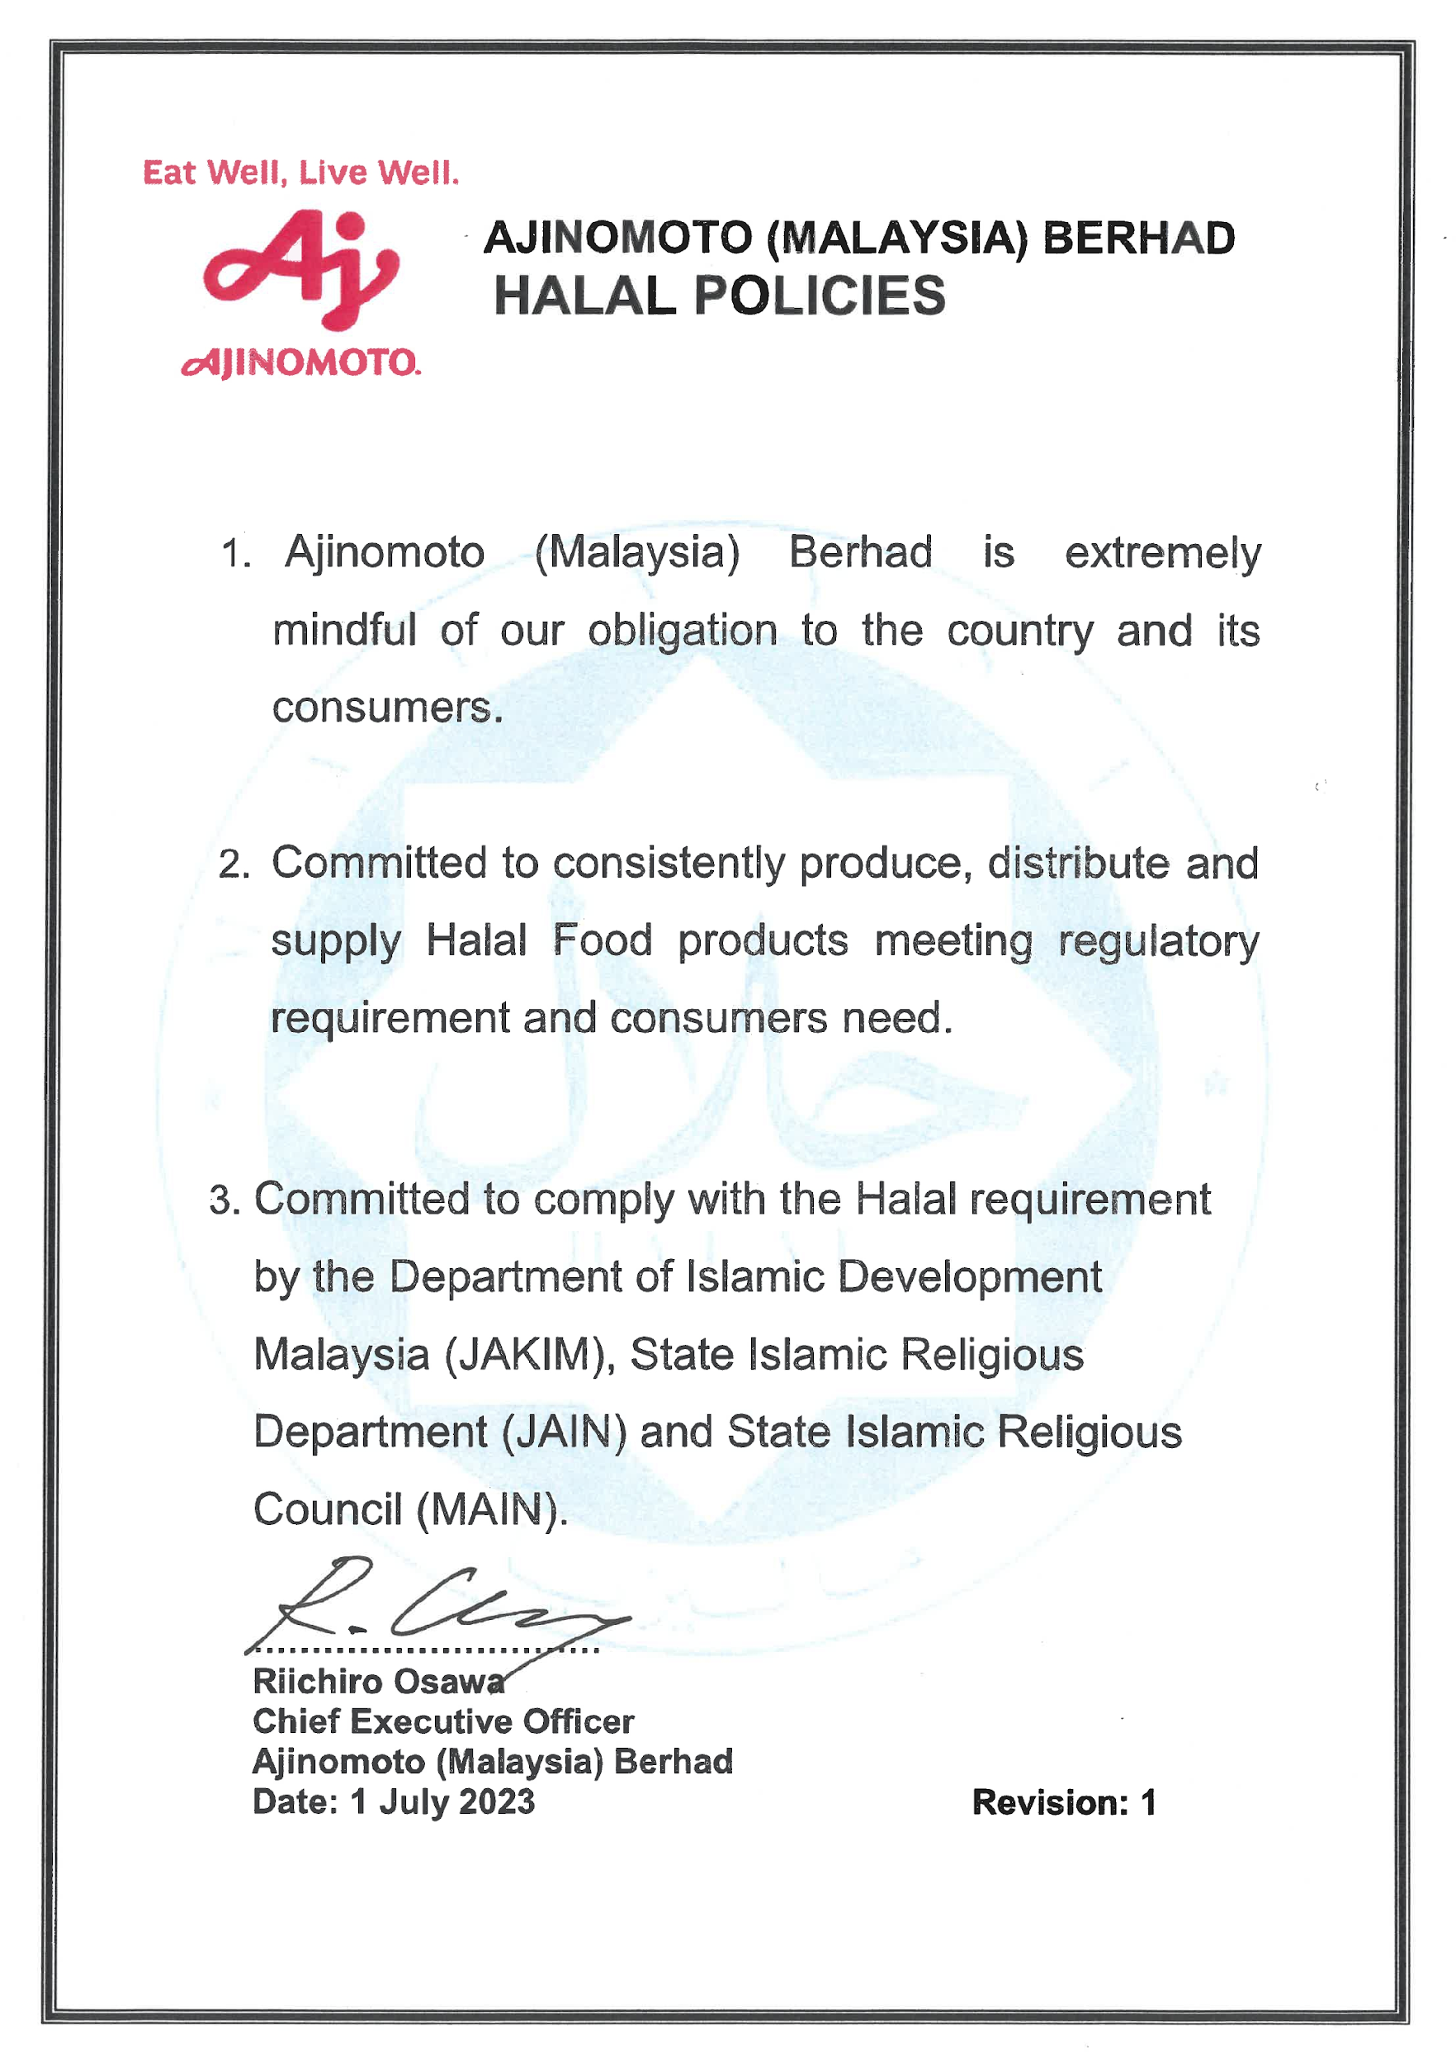
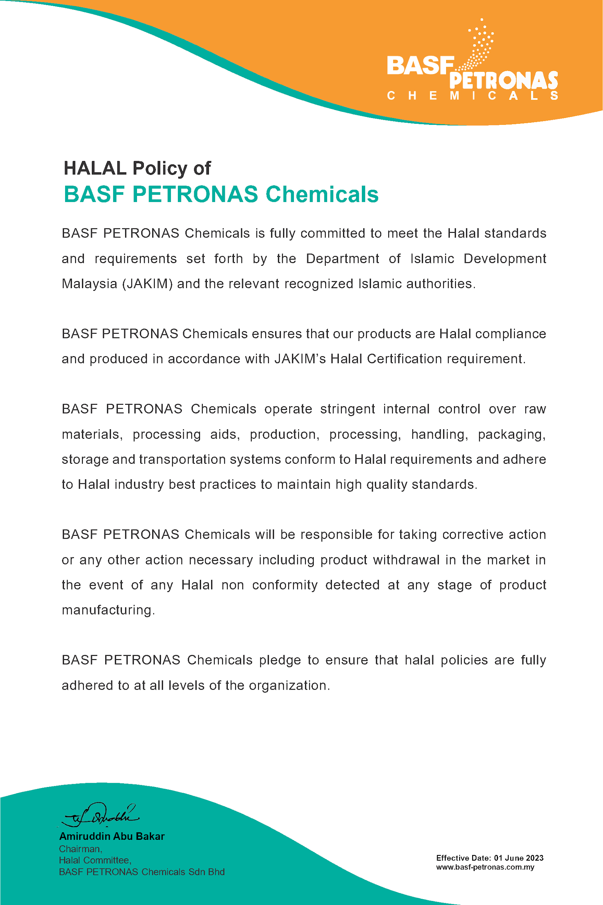
HALAL POLICY & MANAGEMENT COMMITMENT ESTABLISHMENT

Slide 27
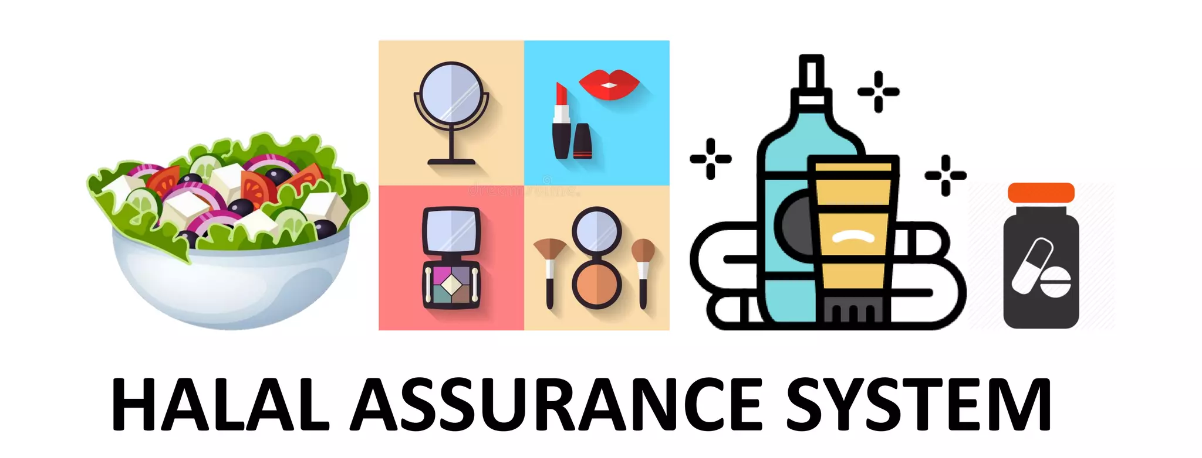
HALAL ASSURANCE SYSTEM (HAS) OVERVIEW INTRODUCTION
What is the Halal Assurance System (HAS)?
Conceptual Explanation
The Halal Assurance System (HAS) is a systematic, documented, and preventive management system established to ensure that products manufactured for halal markets continuously comply with halal requirements.

Slide 28
HALAL ASSURANCE SYSTEM (HAS) OVERVIEW INTRODUCTION
Halal Assurance System (HAS):
Process-based, not religion-based
Preventive, not reactive
Evidence-driven, not assumption-based
Halal compliance is achieved by controlling materials and processes, not by religious belief of employees.

Slide 29
HALAL ASSURANCE SYSTEM (HAS) OVERVIEW INTRODUCTION
Comparison with Other Systems
System | Focus
ISO 9001 | Quality consistency
ISO 22000 / HACCP | Food Safety Hazards
HAS | Halal Integrity Risks
HAS works in parallel with ISO & HACCP, not separately.

Slide 30
OBJECTIVES OF HAS
The main objective of implementing HAS is to ensure production of genuine halal products or services for the consumer.
In achieving this objective, commitment from the top management is an absolute must.
The top management’s responsibilities do not only cover monitoring aspects, but also in providing sufficient manpower, premise, processing facilities, materials and training.
One of the important components in implementing HAS is manpower.
HAS requires trained and competent personnel to establish, implement, monitor, control and verify it.
These tasks are conducted by a group of personnel that portray their responsibility in managing halal.

Slide 31
SCOPE OF HAS
Supplier approval
Receiving
Storage
Processing
Packaging
Distribution
Use a factory flow diagram

Slide 32
BENEFITS OF HAS
Parties | Benefits
Consumers | Informed choice in buying genuine halal products and services Value-for-money halal products or services that are Shariah compliant. Provide with trustworthy halal products or services through the integrated; stringent and systematic and systematic application of a halal control system; and Served with products or services that comply with the halal concept, which focuses on both the halal and the quality of products or services offered.

Slide 33
BENEFITS OF MHMS
Parties | Benefits
Manufacturers | Compliance with regulatory requirements for special categories of products or services i.e. halal; the ability to fulfill clients’ or customers’ requirements for halal products or services; Customers’ confidence and trust in halal products and/or services provided; A marketing tool to attract customers and consumers towards their halal products and/or services; A tool that can facilitate trade within both the local and international market through recognition from implementation of a comprehensive halal assurance management system; Ability to build strong cooperation and instill ownership towards halal products or services amongst their premise workers; and The knowledge that enables them to eliminate and minimize the potential of halal hazards in the halal products and/or services provided by the applicant.

Slide 34
GROUP ACTIVITY 1
Activity: “Why HAS Matters in Organisation”
Divide participants into small groups (4–5 pax).
Ask each group to discuss:
Why does HAS exist beyond certification?
What could happen if HAS is treated as “documentation only”?
Output
1 spokesperson shares one real risk and one benefit of HAS.

Slide 35
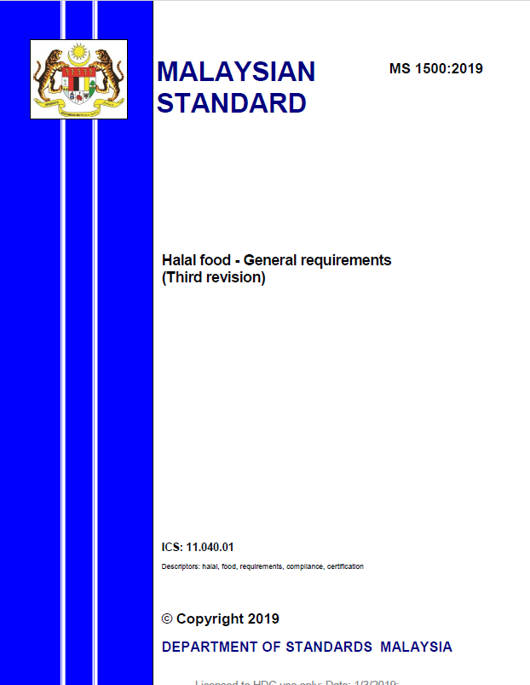
SOURCES OF MHMS REFERENCES - MS
MS 1500:2019 Halal Food – General Requirements (Third revision)
Provides practical guidance for the food industry on the preparation and handling of Halal food (including nutrient supplements) and serves as the basic requirement for Halal food products and food trade or business in Malaysia.
Food & Beverages – Food Premise – Slaughterhouse - OEM

Slide 36
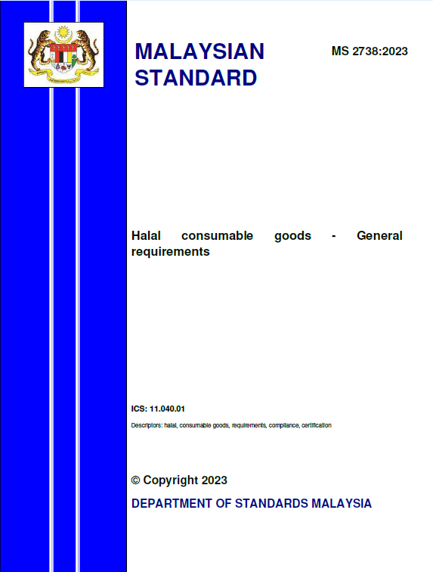
SOURCES OF HAS REFERENCES - MS
MS 2738:2023 Halal consumable goods – General requirements
This Malaysian Standard specifies general requirements in the manufacturing and handling of halal consumable goods
Consumer Goods

Slide 37
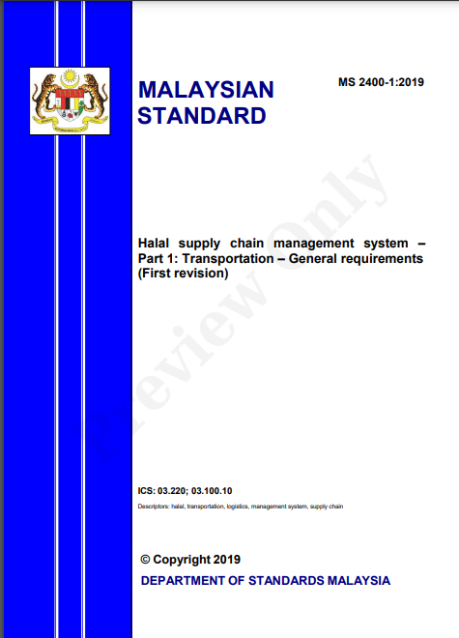
SOURCES OF HAS REFERENCES - MS
MS 2400-1:2019 Halal supply chain management system – Part 1: Transportation – General requirements (First revision)
prescribes the management system requirements for the assurance of the Halal integrity of goods and/or cargo being handled through various modes of transportation.
This standard consists of requirements that are industry specific and is intended to apply to such organizations, regardless of the type and size of the goods and/or cargo being transported.
It prescribes the framework for an organization to establish a management system based on the Halal requirements in meeting customer and applicable regulatory requirements
Halal Logistics - Transportation

Slide 38
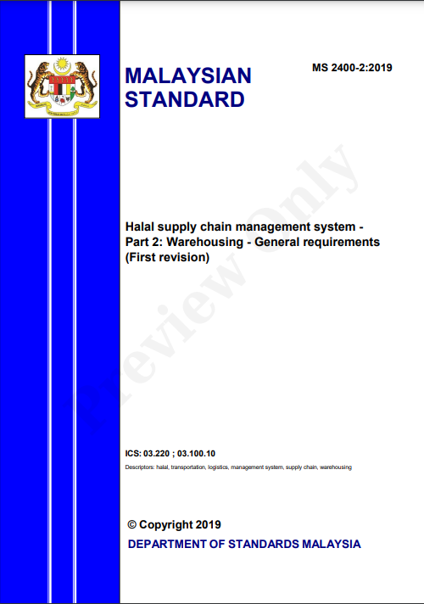
SOURCES OF HAS REFERENCES - MS
MS 2400-2:2019 Halal supply chain management system - Part 2: Warehousing - General requirements (First revision)
prescribes the management system requirements for the assurance of the Halal integrity of products, goods, and/or cargo during warehousing and related activities throughout the process from receiving to delivery.
This standard consists of requirements that are industry specific and is intended to apply to such organizations, regardless of the type and size of the goods and/or cargo being handled and managed
Halal Logistics - Warehousing

Slide 39
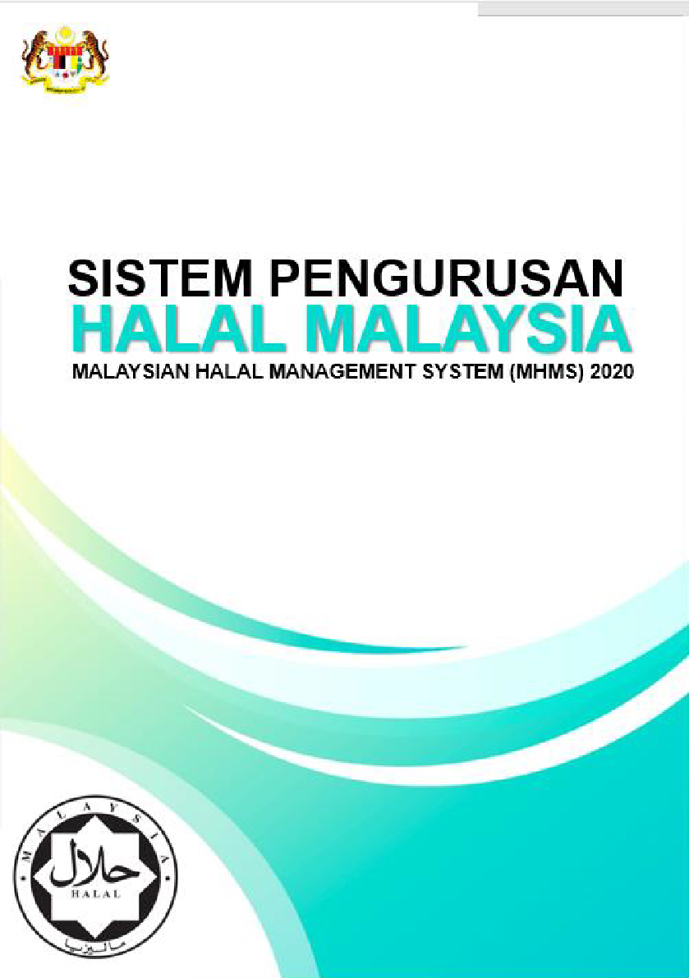
SOURCES OF HAS REFERENCES – MHMS
The Malaysian Halal Management System (MHMS), hereinafter referred to as MHMS 2020, was introduced to replace the Guidelines for Halal Assurance Management System of Malaysia Halal Certification. MHMS 2020 provides detailed guidance on the implementation of MHMS, which includes:
Internal Halal Control System (IHCS) for use by small and micro industries; and
Halal Assurance System (HAS) for use by medium and large industries.
The implementation of MHMS places responsibility on the company and/or applicant to ensure that all requirements of the Malaysian Halal Certification are complied with at all times.

Slide 40
HAS ESTABLISHMENT PROCESS
Preparation
Verification
Approval

Slide 41
HAS ESTABLISHMENT PROCESS
First, prepare the draft manual and policies for all criteria, together with the necessary supporting documents.
Second, obtain verification of the draft documents through the appropriate platform, such as the Internal Halal Committee or the Human Resources meeting, depending on the subject matter.
Finally, once verified, all Halal Assurance Management System criteria must be approved by top management to ensure effective implementation of the HAS.

Slide 42
HAS ESTABLISHMENT PROCESS – HAS MANUAL
The Halal Assurance System (HAS) Manual is a key component of the Halal Assurance Management System.
It ensures the implementation of Halal principles in products and services.
The Internal Halal Committee (IHC) is responsible for developing the HAS Manual as an internal mechanism to monitor, control, improve, and prevent non-compliance in halal production and service delivery.

Slide 43
HAS ESTABLISHMENT PROCESS – HAS MANUAL
to provide a systematic approach to ensure and maintain the halal integrity of products and services.
Objectives of HAS Manual
serves as an internal mechanism for halal monitoring, control, improvement, and prevention of non-compliance.

Slide 44
HAS ESTABLISHMENT PROCESS – HAS MANUAL
The Concept & Principle
Presence of non-halal materials used as ingredients, raw materials and other supporting materials
1
ELIMINATE
potential halal threats to products/services from personnel, equipment, utensil, processing aid and environment
and minimizing potential halal threats throughout the supply chain.
3
2

Slide 45
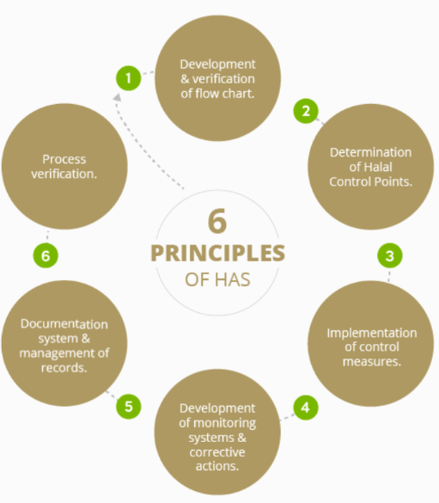
HAS ESTABLISHMENT PROCESS – HAS MANUAL
The Concept & Principle
These are the six (6) important principles of HAS which are also important parts in HAS stages/element that you will learn in the next module.

Slide 46
HAS ESTABLISHMENT PROCESS – HAS MANUAL
First, let’s view the process flow below to get an overview of the process.
Developing Internal Halal Committee (IHC)
Establish IHC
Develop Halal Policy and Objectives
Develop IHC’s Terms of Reference (TOR)
Conduct Halal Risk Management Analysis
Describe product/services
Develop process flow and plant layout diagram
Identify Halal Control Point (HCP)
Develop Halal Risk Management Plan
Develop Monitoring system
Develop corrective action
Develop verification procedure
documentation and records

Slide 47



INTEGRATION WITH EXISTING MANAGEMENT SYSTEMS
Why Integration is Important
Avoid duplication
Reduce training burden
Improve effectiveness

Slide 48


INTEGRATION WITH EXISTING MANAGEMENT SYSTEMS
HAS may integrate with:
ISO 9001
📌 Example
Same cleaning SOP used for:
Food safety
Halal compliance
document control
ISO 22000 / HACCP
risk management
GMP
sanitation & hygiene

Slide 49
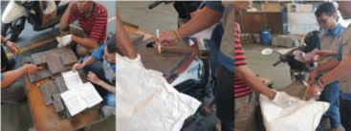

PRACTICAL EXAMPLE
Example 1: Raw Material Control
Purchasing receives new ingredient
QA checks:
Halal certificate
Supplier approval
Material released only after verification
❌ Without verification → Major NCR

Slide 50



COMMON AUDIT FINDINGS RELATED TO HAS
Audit Finding(s) | Risk Level
No halal risk assessment | Major NCR
HAS exists but not implemented | Major NCR
No evidence of monitoring | Major NCR
Records incomplete | Minor/Major NCR
Employees unaware of HAS | Minor NCR

Slide 51


HALAL CONTROL & DOCUMENTATION SYSTEM
The Halal Control & Documentation System ensures that all activities affecting halal integrity are properly controlled, documented, and traceable. It provides a framework for preventive control, auditable records, and evidence for certification.
If it is not documented, it did not happen

Slide 52
HALAL CONTROL & DOCUMENTATION SYSTEM OBJECTIVES
Ensure all materials, processes, and products comply with halal requirements
Provide clear instructions for employees on halal control procedures
Maintain records as evidence for auditors and certification bodies
Facilitate monitoring, verification, and continuous improvement
Support traceability from raw materials to finished products

Slide 53

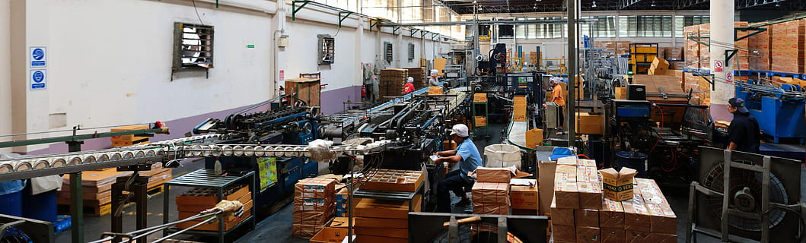
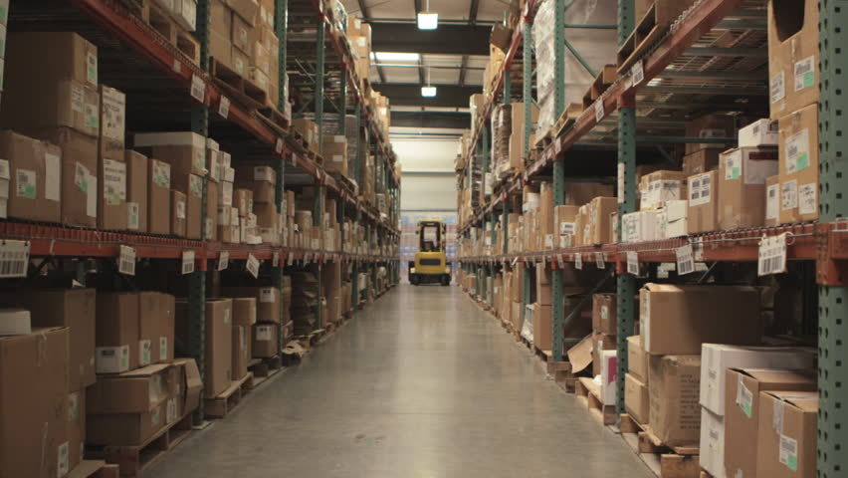




HALAL CONTROL & DOCUMENTATION SYSTEM SCOPE
Supplier and material management
Production and processing
Storage and warehousing
Cleaning and sanitation
Packaging and labelling
Distribution and logistics
Supporting functions (maintenance, calibration, training)

Slide 54
HALAL CONTROL & DOCUMENTATION SYSTEM
Key Components
Halal Control Procedures (SOPs)
Halal Documentation
Document Control
Control of External Documents
Record Control & Traceability
Monitoring, Verification, and Audit

Slide 55
HALAL CONTROL & DOCUMENTATION SYSTEM KEY COMPONENTS
Halal Control Procedures (SOPs)
Purpose: Ensure consistent halal compliance in every activity
Content of SOPs:
Purpose & scope
Responsibilities
Step-by-step instructions
Verification / monitoring points
Records to be maintained

Slide 56
HALAL CONTROL & DOCUMENTATION SYSTEM KEY COMPONENTS
Halal Control Procedures (SOPs)
Examples:
Area | SOP Example | Control Purpose
Receiving | Verify halal certificate & supplier approval | Prevent non-halal material entry
Storage | Segregation of halal and non-halal | Avoid cross-contamination
Processing | Equipment changeover & cleaning | Maintain halal integrity
Packaging | Correct label application | Ensure halal product identification
Cleaning | Approved chemical usage | Prevent contamination
Waste | Disposal of non-halal waste | Prevent cross-contact

Slide 57
HALAL CONTROL & DOCUMENTATION SYSTEM KEY COMPONENTS
Halal Documentation
Types of Documentation:
All documents must be controlled, up-to-date, accessible, and auditable.
Halal/HAS Manual
overarching system guide
SOPs
detailed work procedures
Work Instructions
for specific operations
Forms / Checklists
daily/weekly/shift records
Registers
supplier, training, corrective actions
Certificates
halal certificates from suppliers

Slide 58


HALAL CONTROL & DOCUMENTATION SYSTEM KEY COMPONENTS
Document Control
Purpose: Prevent misuse or outdated documents from affecting halal compliance.
Requirements:
Each document must have:
Code / number
Version & revision date
Approval signature
Only the current version can be used in operations
Obsolete documents must be removed or clearly marked

Slide 59
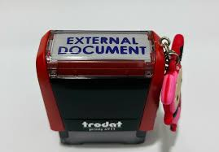

HALAL CONTROL & DOCUMENTATION SYSTEM KEY COMPONENTS
Control of External Documents
Supplier halal certificates, fatwa, or regulatory documents are considered external documents
Must be:
Verified for validity
Recorded in the approved supplier list
Updated regularly

Slide 60
HALAL CONTROL & DOCUMENTATION SYSTEM KEY COMPONENTS
Record Control & Traceability
Purpose: Provide evidence for audits and allow full traceability
Types of Records:
Receiving inspection checklist
Cleaning logs
Production batch records
Storage & segregation logs
Training attendance
Internal audit reports

Slide 61
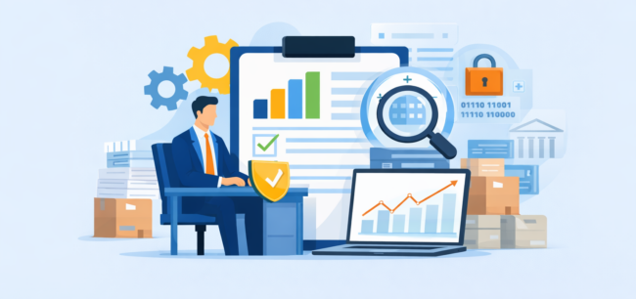


HALAL CONTROL & DOCUMENTATION SYSTEM KEY COMPONENTS
Monitoring, Verification, and Audit
Monitoring: Daily checks by supervisors
Verification:
Internal halal audits
Review of records and documentation Improvement:
Corrective Action Requests (CARs)
Preventive measures for repeat issues
Missing cleaning log → CAR raised → retraining conducted → monitored for 2 weeks

Slide 62
HALAL CONTROL & DOCUMENTATION SYSTEM MAINTENANCE OF HAS
All HAS documents shall be reviewed periodically to ensure continued relevance, accuracy, and effectiveness.
The review outcome may include revision, amendment, reconfirmation, supersession, or withdrawal of documents.
all HAS documents shall be reviewed at least once a year.
Immediate review shall be conducted when there are changes in the Internal Halal Committee (IHC), operational monitoring schedules, or any changes in operations and/or the supply chain.

Slide 63
HALAL CONTROL & DOCUMENTATION SYSTEM MAINTENANCE OF HAS
The document review process begins when the Halal Personnel submits a document review report to the IHC.
Document Review Process
The IHC will review the report and decide whether the document should be revised, amended, reconfirmed, superseded, or withdrawn.
The Halal Compliance Officer/Executive is responsible for updating and implementing the IHC’s decision.

Slide 64
HALAL CONTROL & DOCUMENTATION SYSTEM MAINTENANCE OF HAS
Documents subject to review include, but are not limited to:
Company Halal Policy
IHC and Halal Team members’ profiles
Halal Training Manual
Halal Assurance System Manual
Halal Assurance Management System references from other countries
Halal compliance references
Documentation and record formats
Product release records
Testing, validation, and related records
Halal product profiles, specifications, characteristics, and process flow charts
Halal Control Point (HCP) HAS document and record retention periods
Validity duration and project development timelines

Slide 65

FINAL ASSESSMENT
https://forms.gle/F1WkvXqj1eUdERTB9

Slide 66

www.hdcglobal.com

